Slide 1
Detecting Buliding Defets Using Convolutional Neural Network

Slide 2
Presented by:
S.Sheetal
G.Ratna Shree
C.Avanthika
R.Sampoorna Lakshmi
Guide:Rajashekara sastry

Slide 3
ABSTRACT
Clients are increasingly looking for fast and effective means to quickly and frequently survey and communicate the condition of their buildings so that essential repairs and maintenance work can be done in a proactive and timely manner before it becomes too dangerous and expensive.Traditional methods for this type of work commonly comprise of engaging building surveyors to undertake a condition assesment which involves a lengthy site inspection cost estimates immediate and projected long-term costs of renewal,repair and maintenance of the building.Current assest condition assesment procedures are extensively time consuming,laborious,and expensive and pose health and safety threats to surveyors,particularly at height and roof levels which are difficult to acess

Slide 4
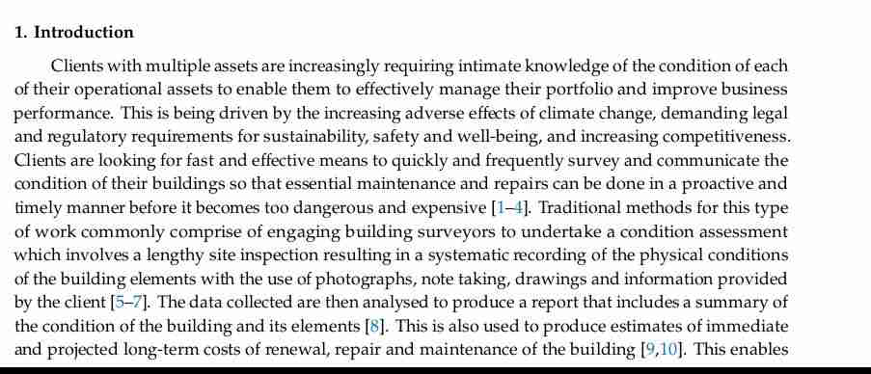
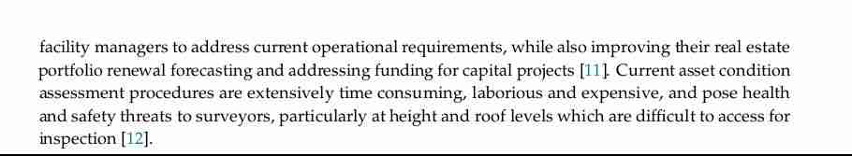

Slide 5
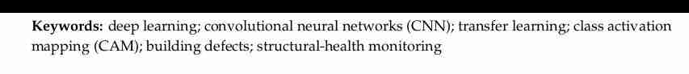

Slide 6
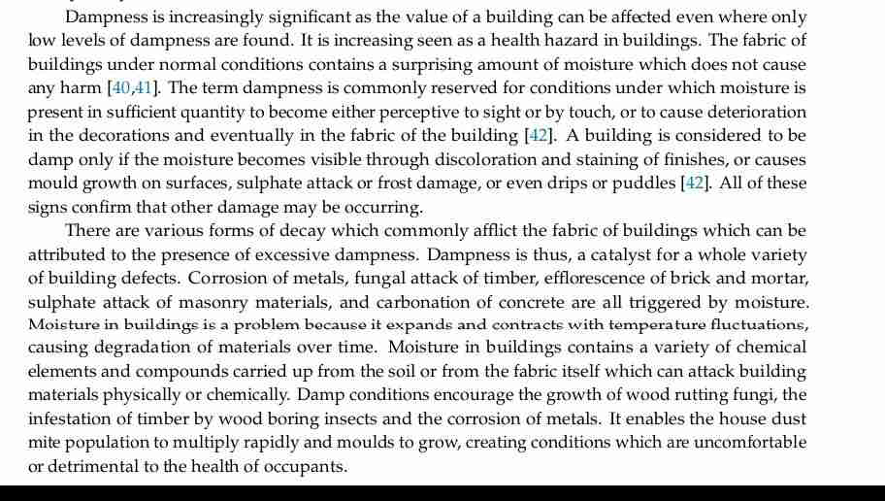
2. Dampness Signficant

Slide 7
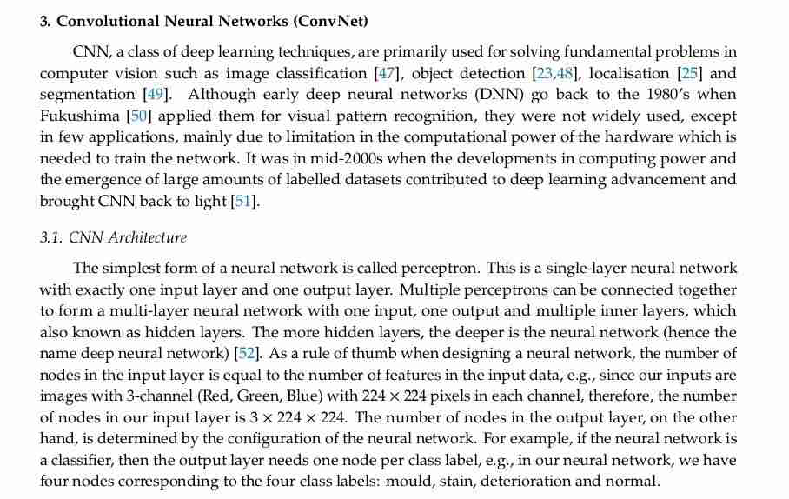

Slide 8
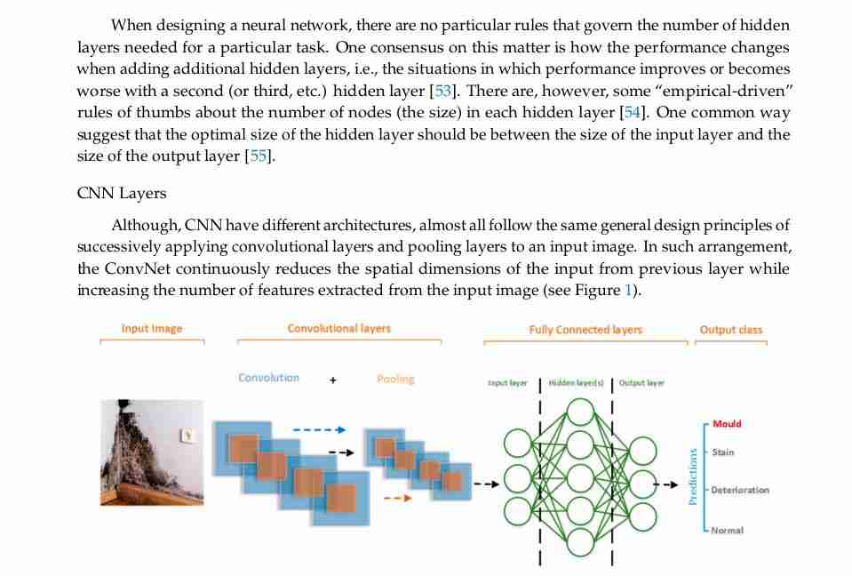

Slide 9
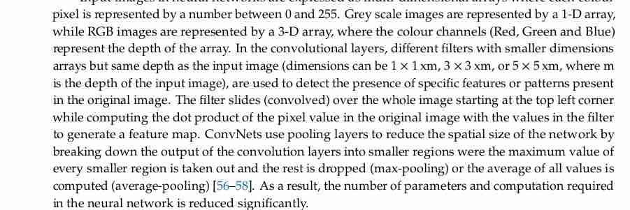

Slide 10
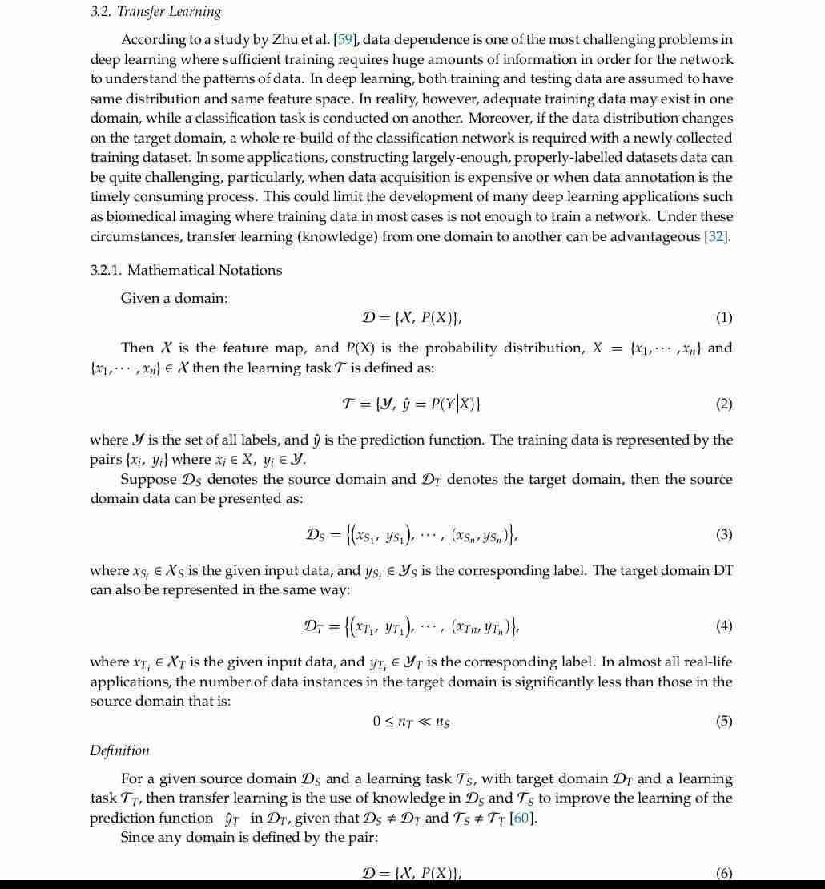

Slide 11
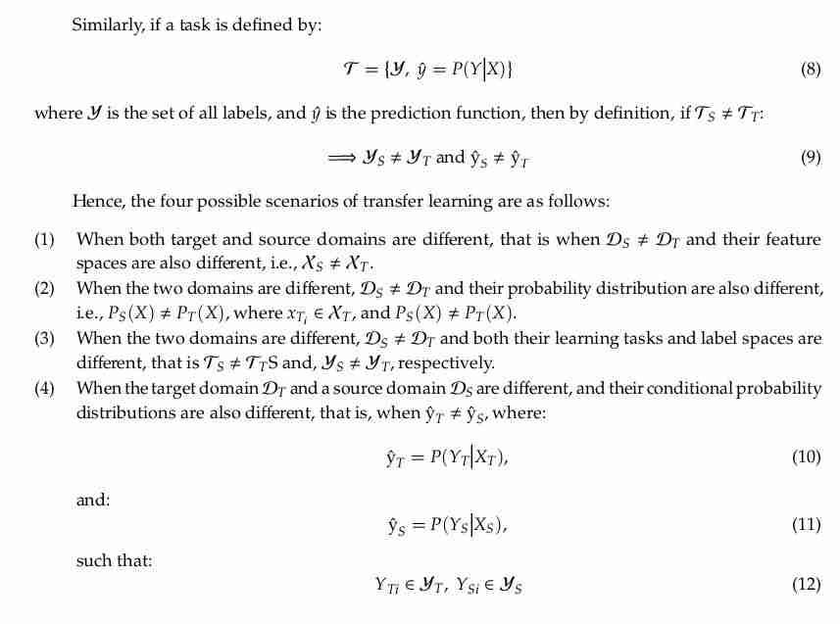

Slide 12
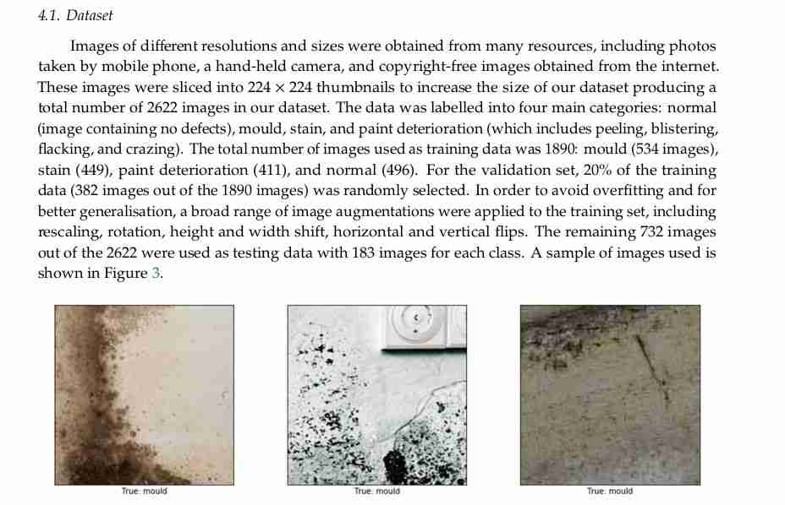

Slide 13
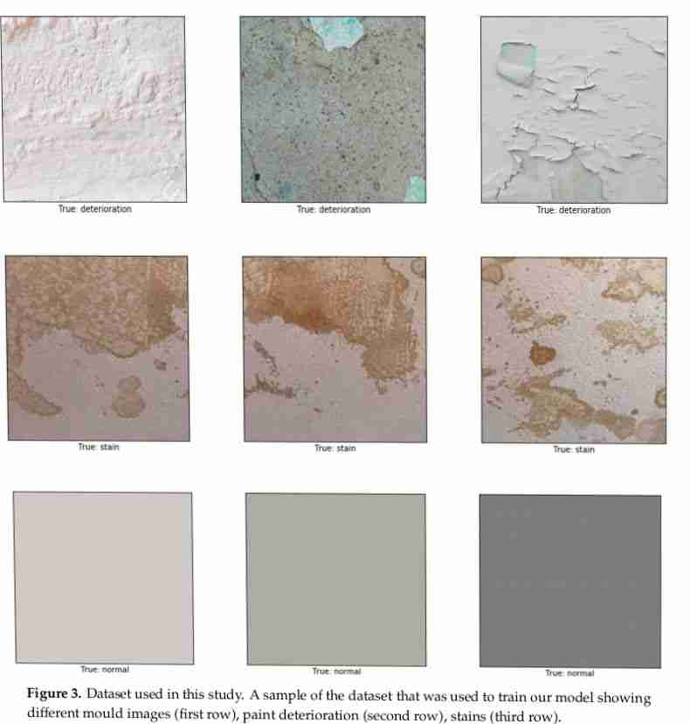

Slide 14
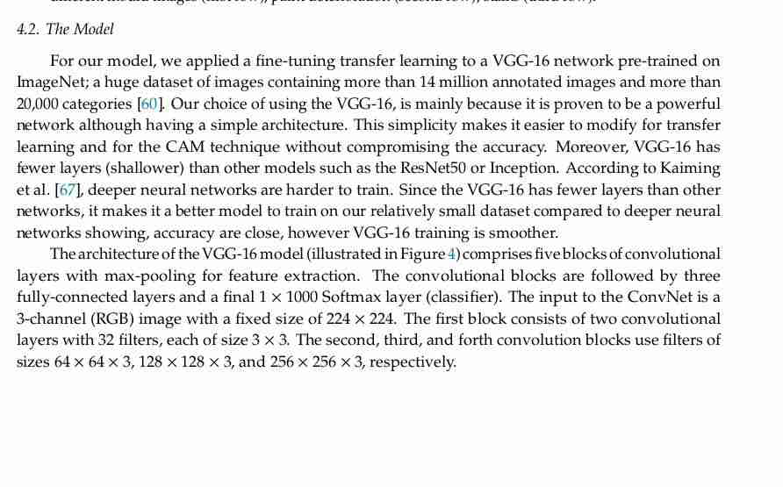

Slide 15
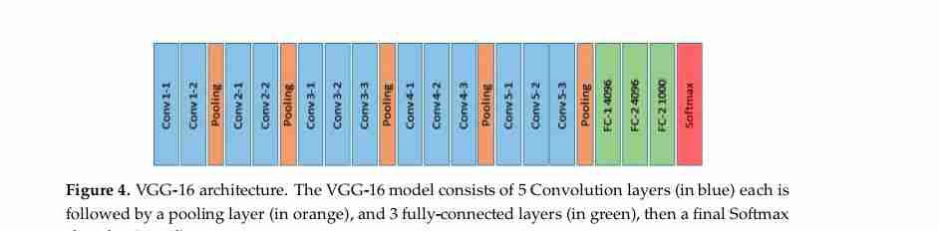

Slide 16
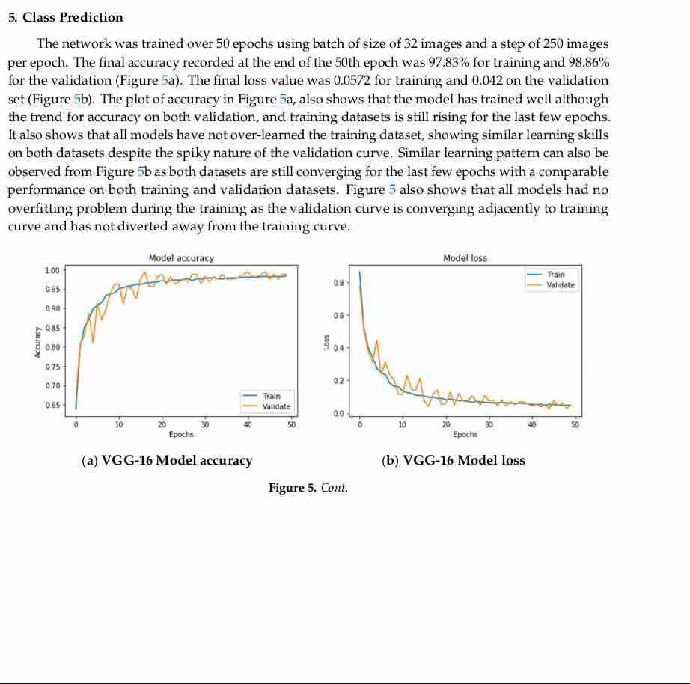

Slide 17
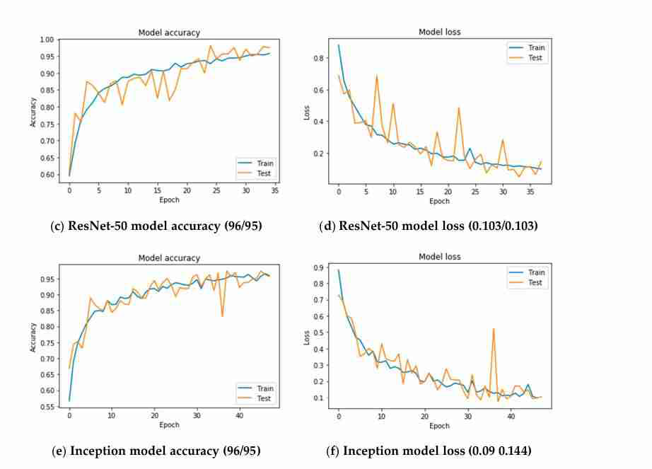

Slide 18
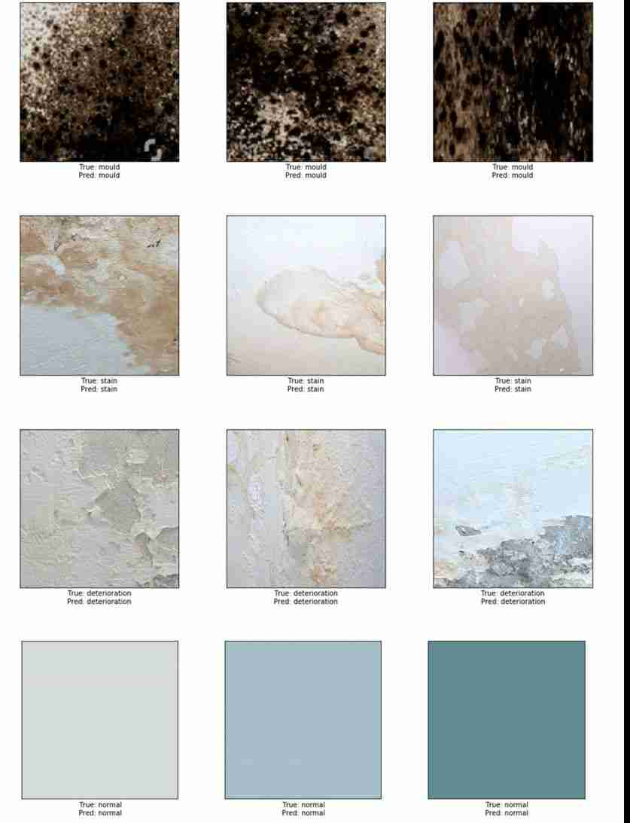

Slide 19
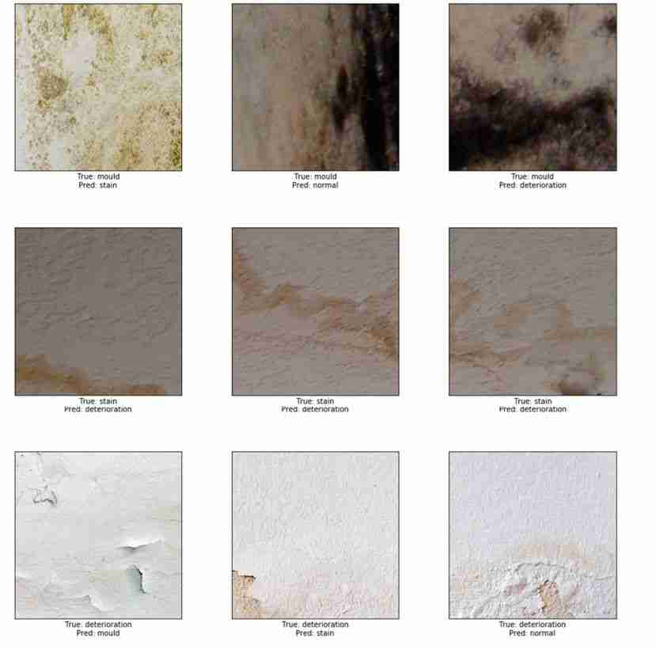

Slide 20
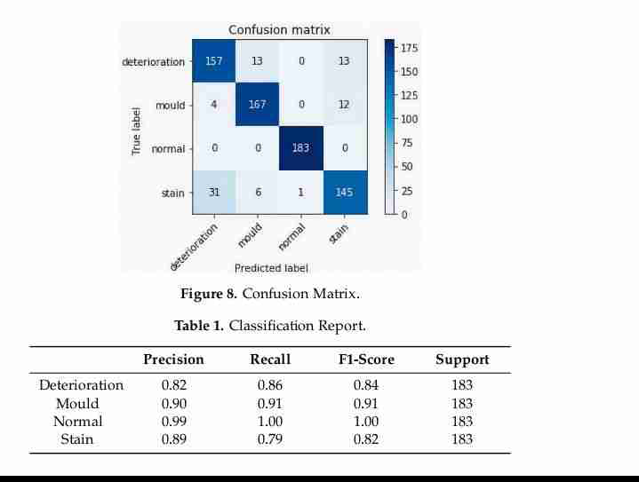

Slide 21
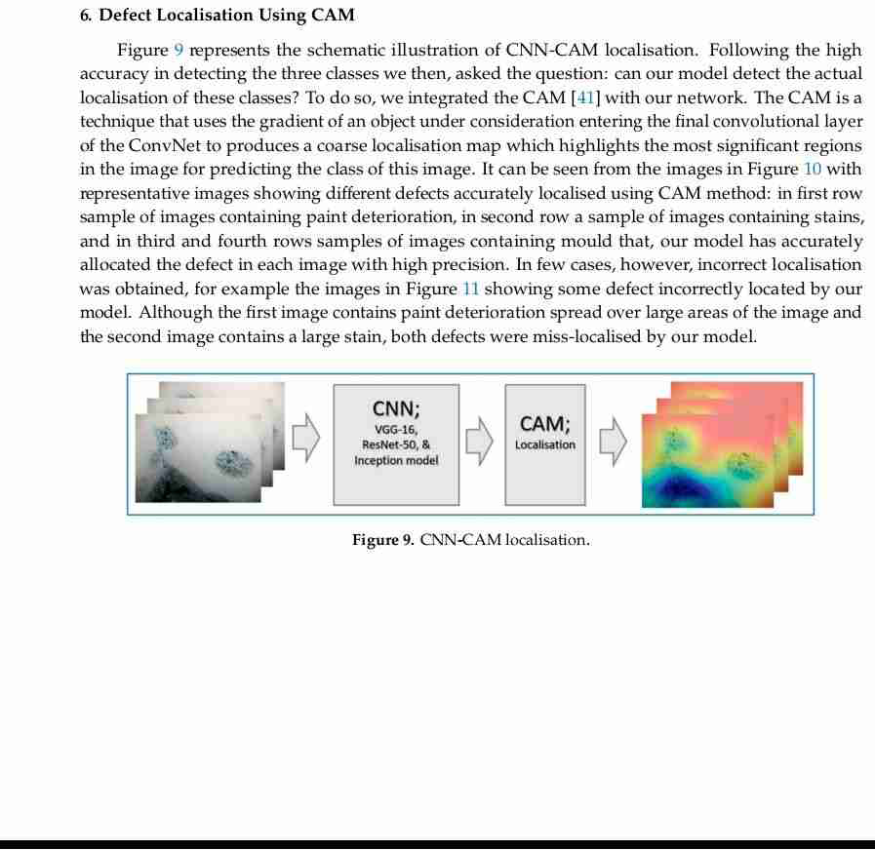

Slide 22
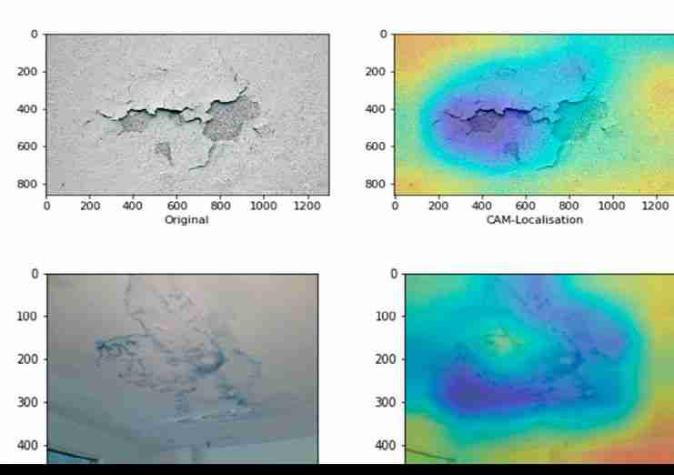

Slide 23
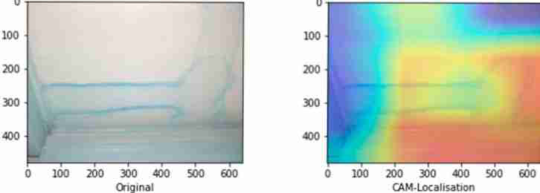

Slide 24
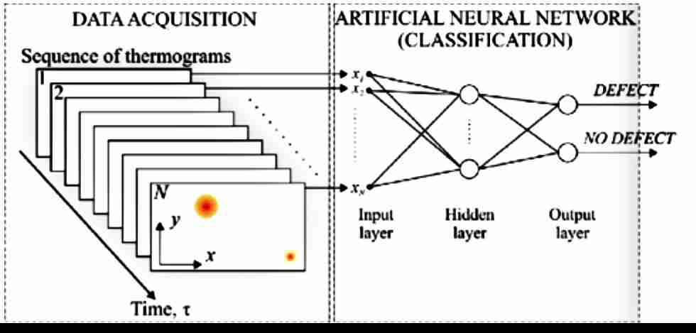

Slide 25
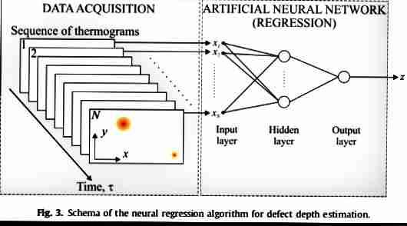

Slide 26
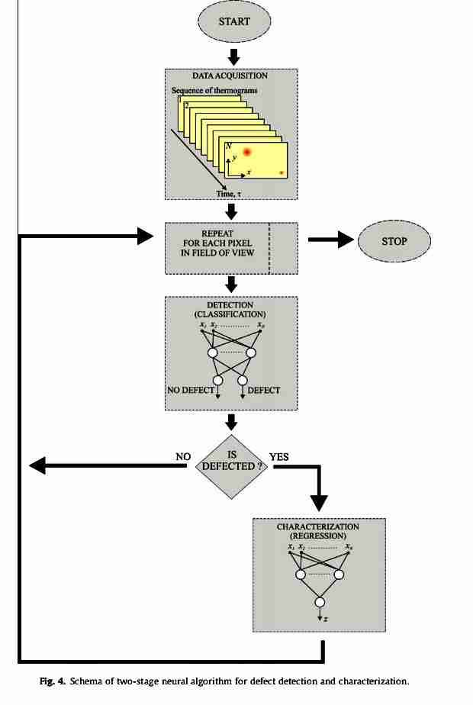

Slide 27
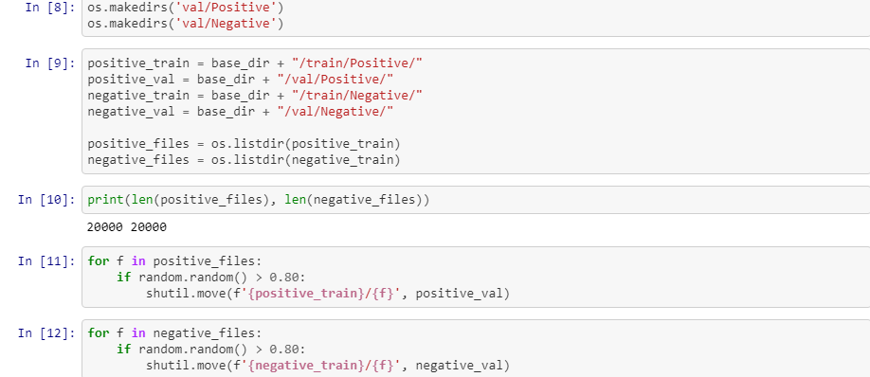

Slide 28
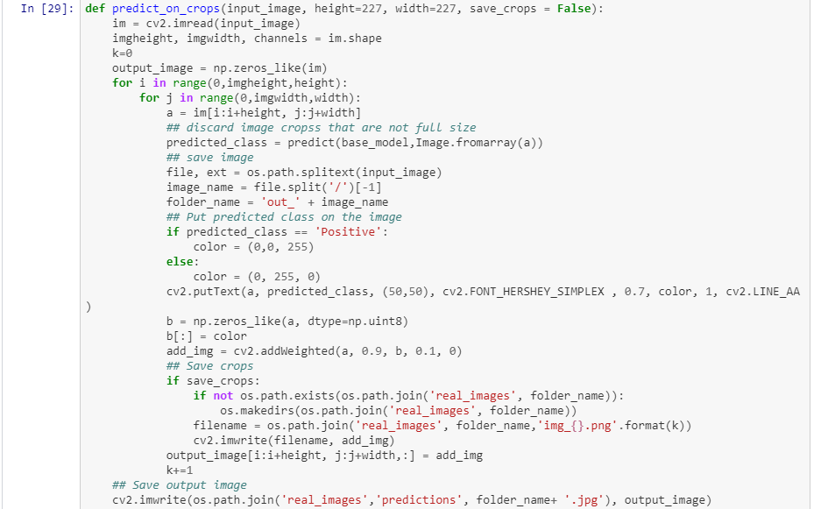

Slide 29
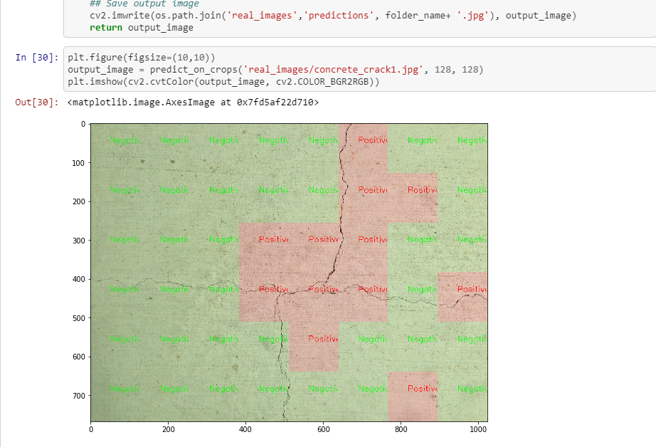

Slide 30
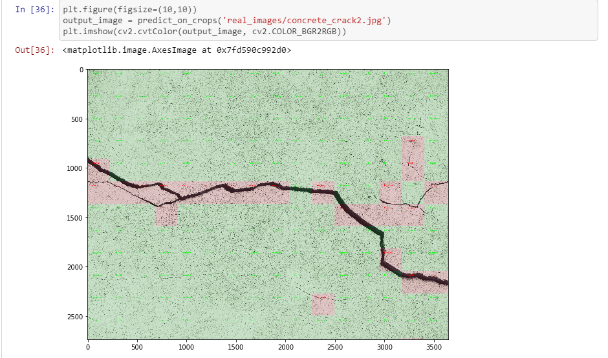

Slide 31
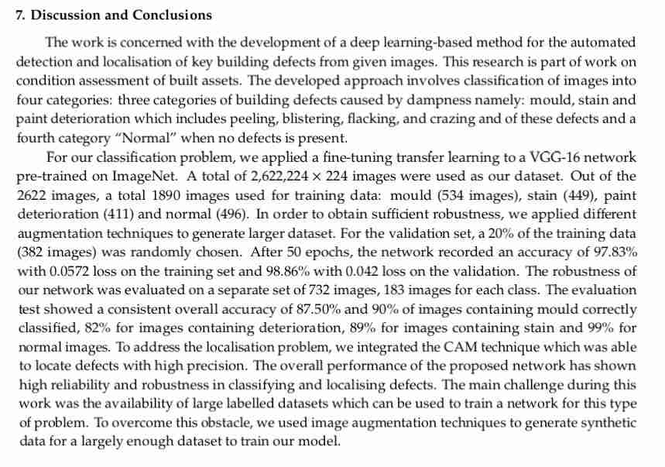

Slide 32
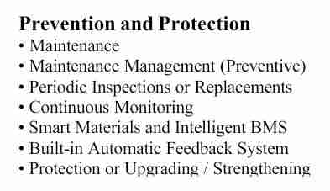

Slide 33
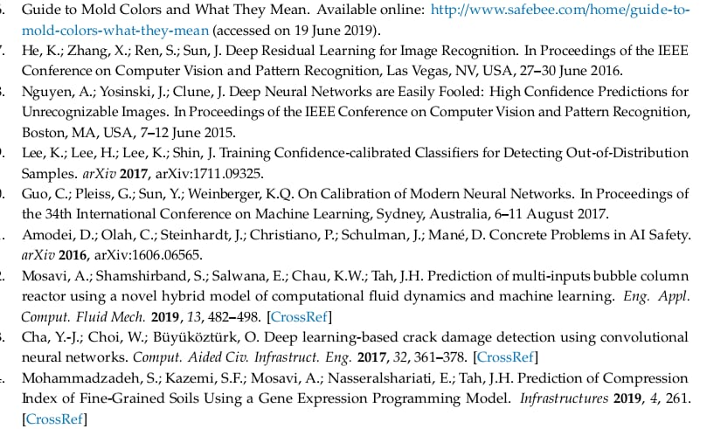
references

